Slide 1
Linear Regression

Slide 2
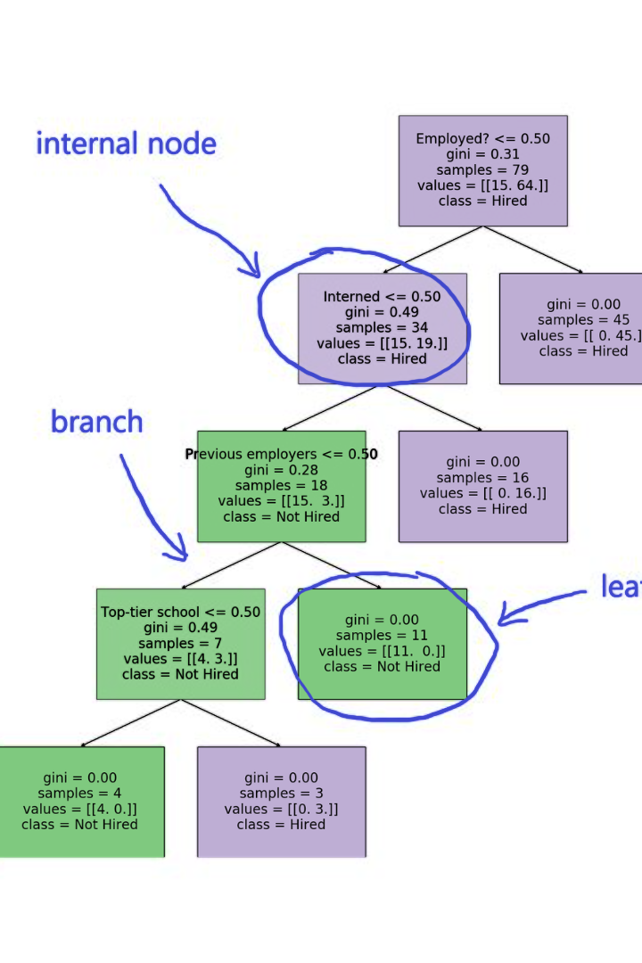
Introduction to Supervised Learning
Supervised learning is a machine learning technique where an algorithm learns from labeled training data to make predictions or decisions. It involves input features and output labels, allowing the model to learn the mapping function from the input to the output.

Slide 3
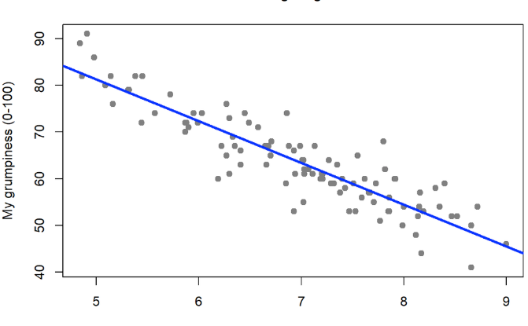
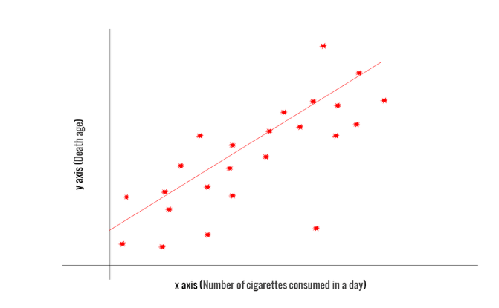
Overview of Linear Regression
Simple & Effective
Equation Representation
Linear regression is a simple yet powerful technique for predicting quantitative values based on one or more input features. It's widely used in various fields due to its interpretability and ease of implementation.
Linear regression models can be represented by an equation that describes the relationship between the input variables and the output. This makes it easy to understand and interpret the model.

Slide 4
Understanding Features and Labels
Features
Labels
Features are the input variables that are used to make predictions. They can be numerical or categorical, and their quality and relevance greatly impact the model's performance.
Labels are the output or the target variable that the model aims to predict. They are the values that the model learns to approximate based on the input features.

Slide 5
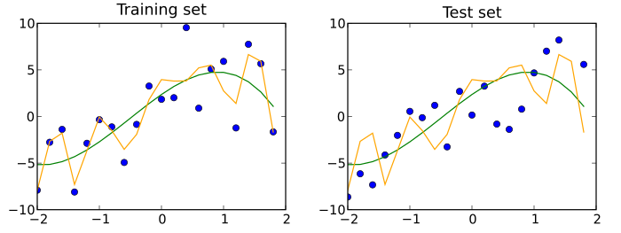
Explaining Training and Testing
1
Training Data
During training, the model learns from the labeled data to understand the patterns and relationships between the features and the labels.
2
Testing Data
The testing data is used to evaluate the model's performance and generalization on new, unseen data. It helps assess how well the model can make predictions.
3
Validation Set
Some data is often reserved for a validation set to fine-tune the model and prevent overfitting, ensuring it performs well on unknown data.

Slide 6
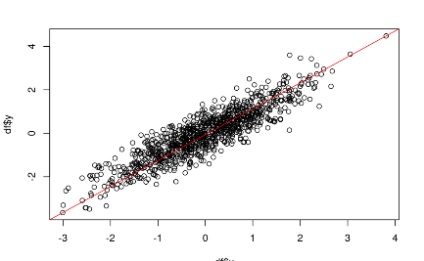
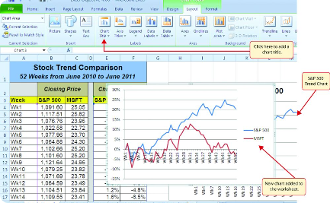
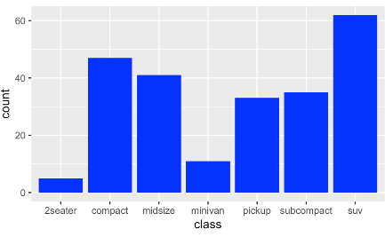
Visualizing Data with Charts and Diagrams
Scatter Plots
Line Charts
Bar Graphs
Scatter plots are effective for visualizing relationships between two numerical variables, helping to identify patterns and correlations in the data.
Line charts are useful for showing trends and changes over time, making them valuable for time-series data analysis and trend visualization.
Bar graphs are suitable for comparing categories or groups, making comparisons and identifying differences in performance or frequency.

Slide 7
Importance of Data Preprocessing
1
Data Quality
2
Scaling & Normalization
3
Feature Engineering
Preprocessing helps identify and handle missing data, outliers, and inconsistencies, ensuring the quality and reliability of the data for model training.
Creating new features or transforming existing ones can enhance the model's predictive power and relevance to the problem at hand.
Scaling features to a similar range and normalizing data can improve model performance, preventing certain features from dominating the learning process.

Slide 8
Interpreting Results and Making Predictions
Interpretation
Predictions
Interpreting coefficients and feature importance can provide insights into the relationship between the features and the outcome, enabling decision-making.
Using the trained model to make predictions on new data can facilitate forecasting, risk assessment, and decision support in various applications.

Slide 9
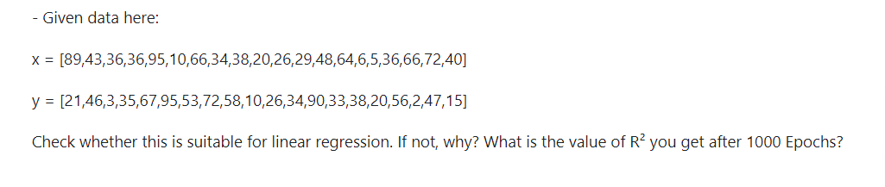
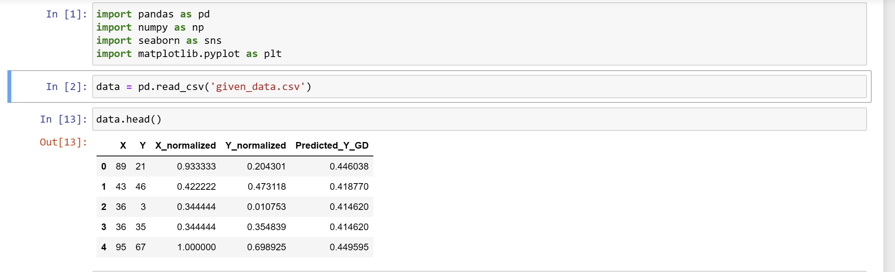
In this program, we have imported and read the given sample data. During programming we had plot a graph and
found that this data is extremely fluctuating as well as after visualising the graph it is not suitable for linear regression.

Slide 10
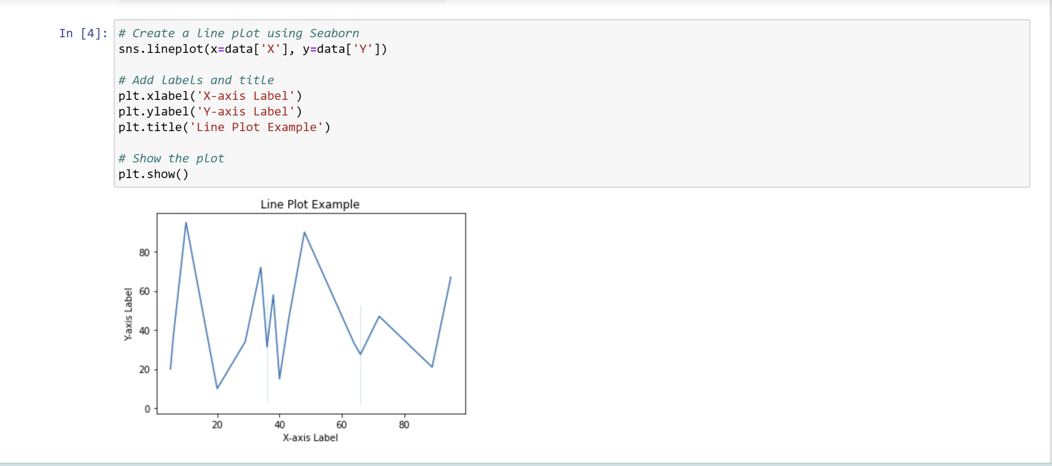

Slide 11
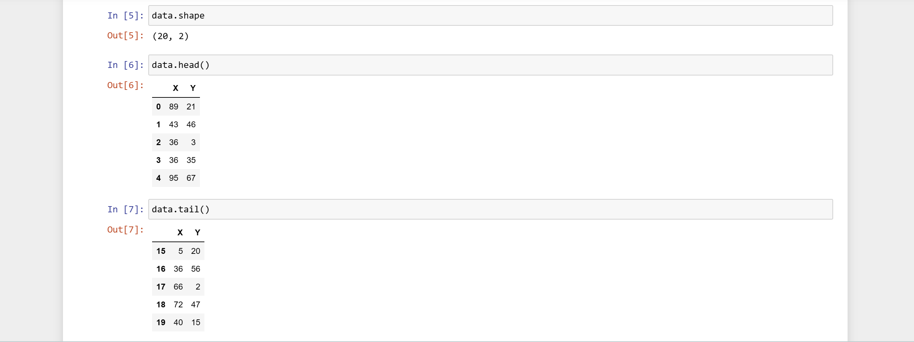
Despite our attempts to program with the provided data, we encountered errors. As a solution, we decided to normalize the given data values to smaller scales to eliminate errors. Subsequently, we ran the program using the normalized X and Y data values. We also created a graph to visually compare the normalized values with the original data.
The original values proved incompatible for implementing gradient descent. However, after normalization, we successfully computed the gradient descent value, and it turned out to be negative, which is an expected outcome.

Slide 12
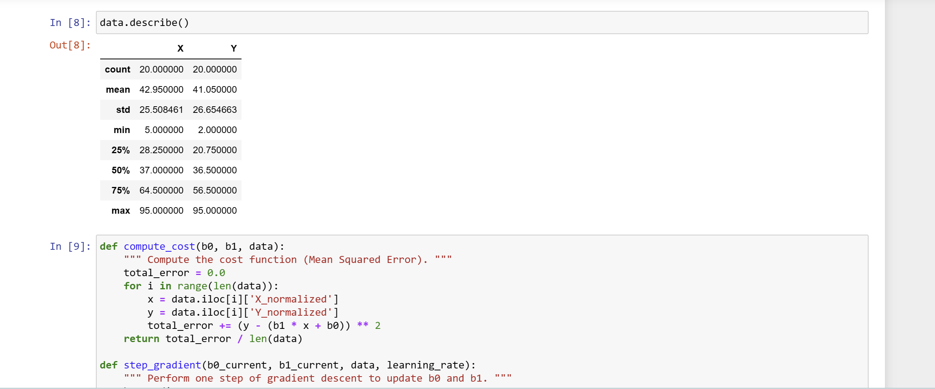

Slide 13
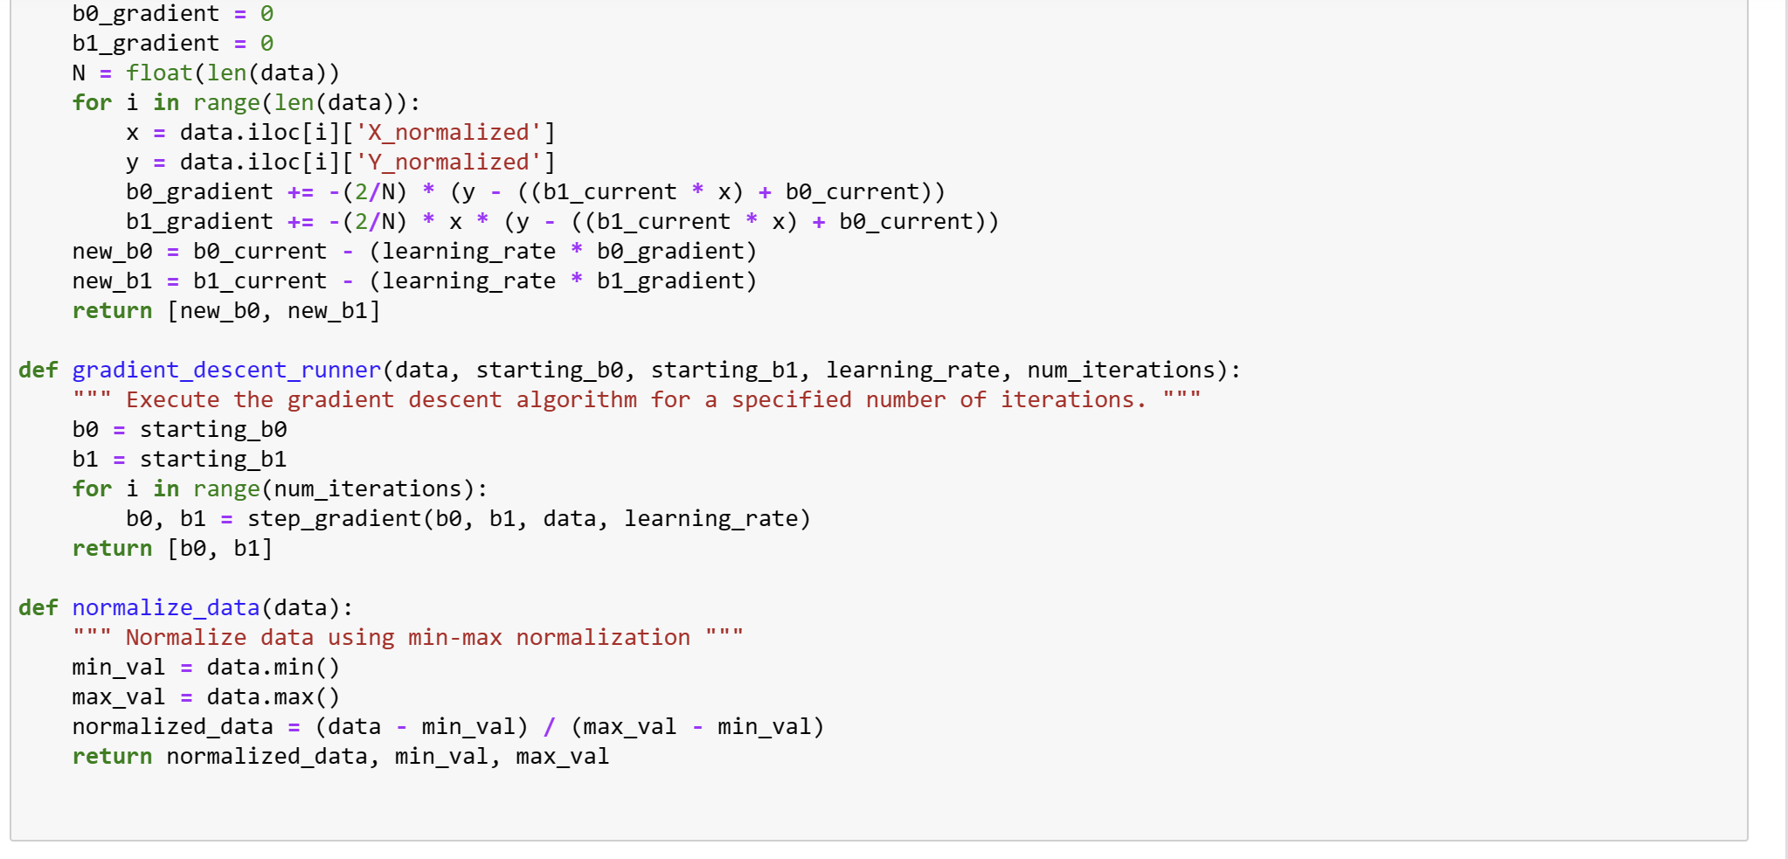

Slide 14
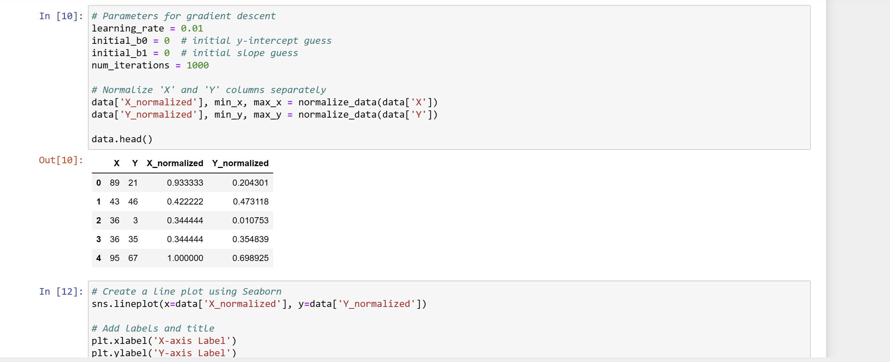

Slide 15
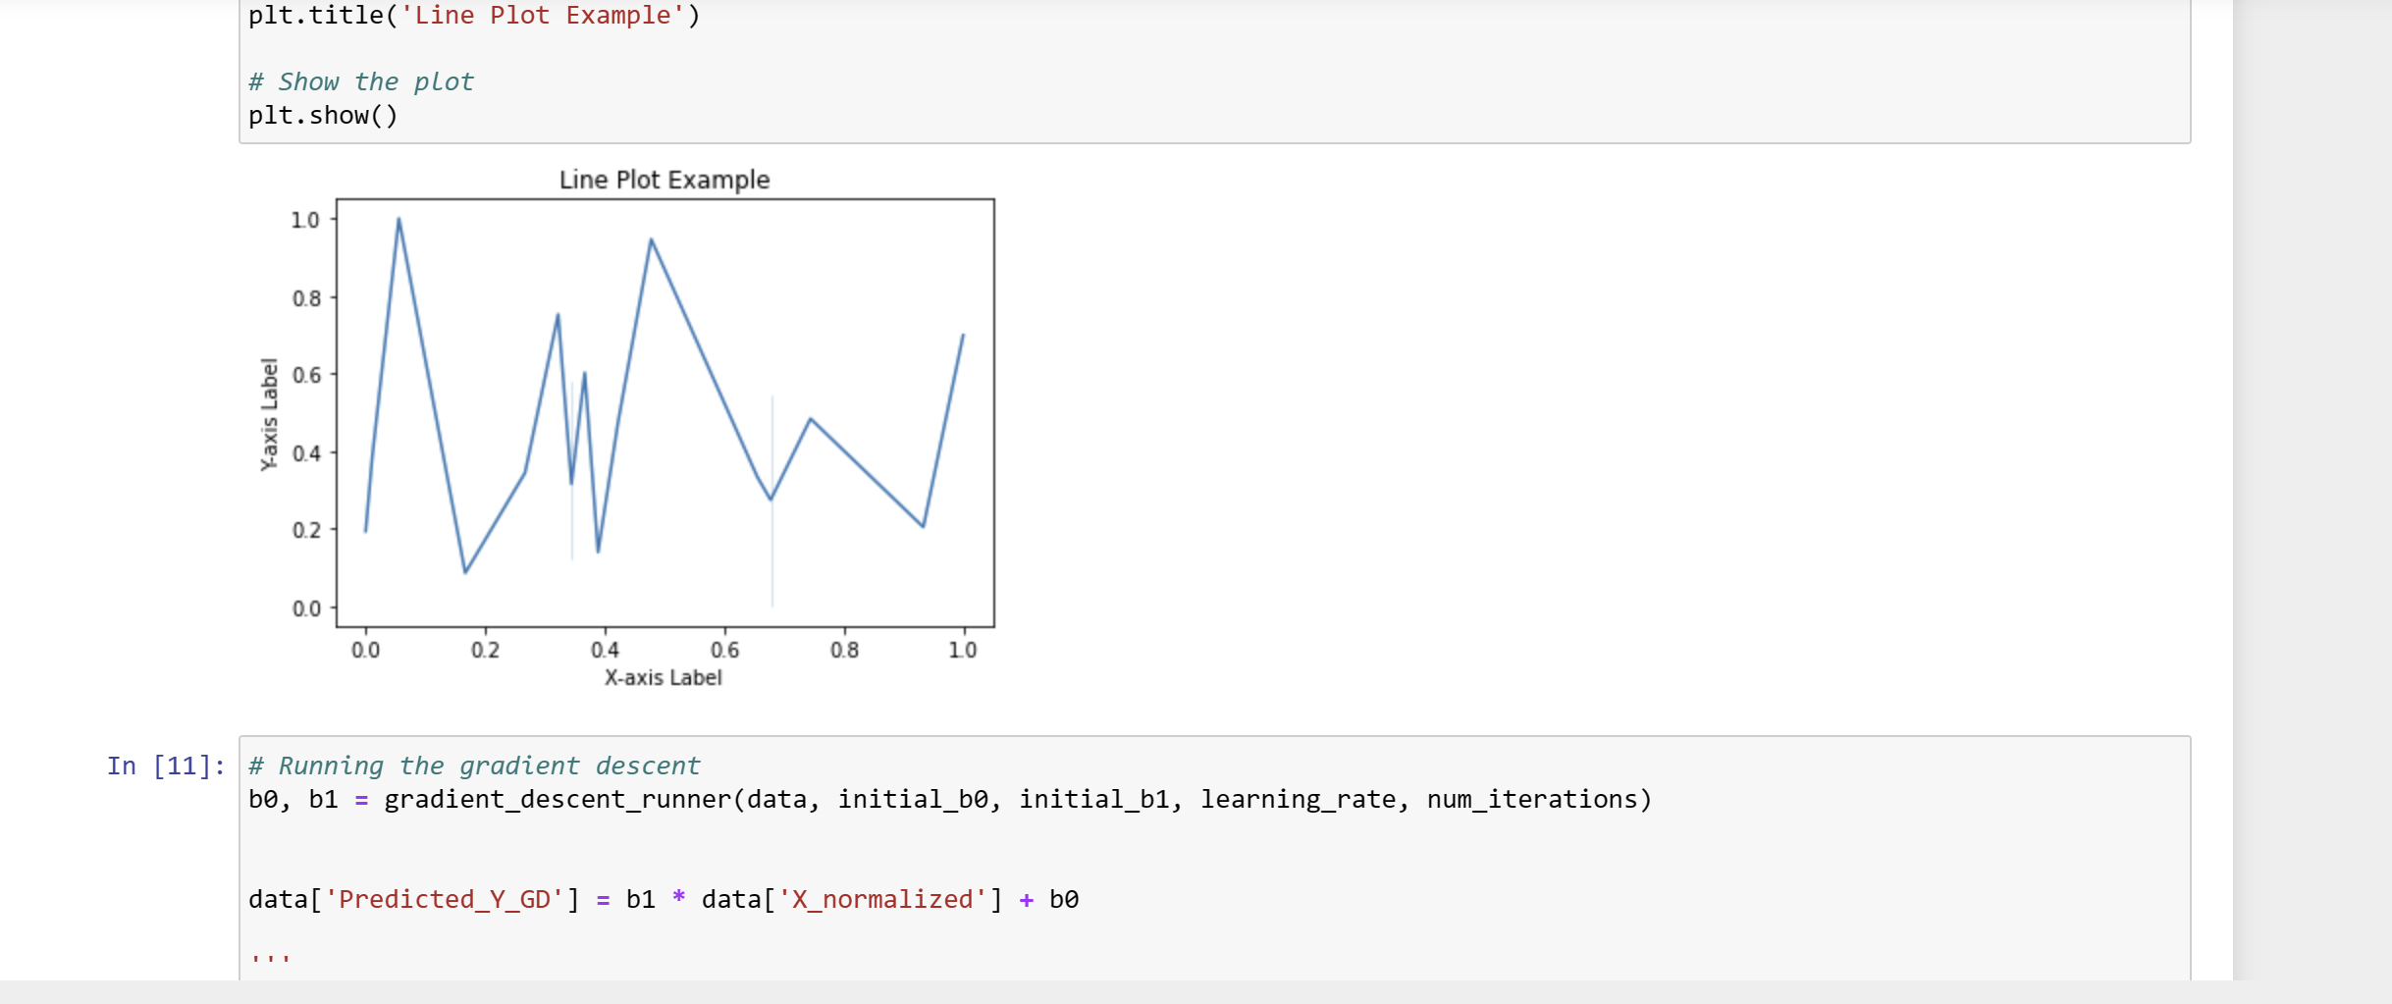
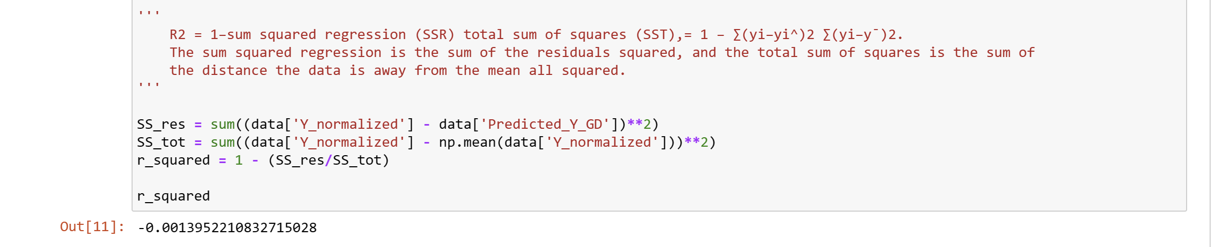

Slide 16
Conclusion and Future Directions
1
Applications
2
Advanced Techniques
3
Ethical Considerations
Linear regression has widespread applications in economics, finance, healthcare, and social sciences, with potential for further integration into emerging fields.
Exploring advanced linear regression techniques such as polynomial regression and time-series regression opens doors to solving complex, real-world problems.
Addressing ethical considerations in model development, data usage, and decision-making is crucial for responsible and fair deployment of linear regression models.

